Slide 1

HotStuff: BFT Consensus in the Lens of Blockchain
Weisu Yin, Weijia Xing

Slide 2
Overview
Why HotStuff
Basic HotStuff
Chained HotStuff

Slide 3
Why HotStuff
BFT SMR protocols target system size was small
PBFT is complex and slow
Notes:
When BFT SMR protocols were originally conceived, a typical target system size was n = 4 or n = 7, deployed on a local-area network. However, the renewed interest in Byzantine fault-tolerance brought about by its application to blockchains now demands solutions that can scale to much larger n.
Conveying a new proposal has a communication footprint of O(n^3 ) authenticators in PBFT, and variants that combine multiple authenticators into one via threshold digital signatures still send O(n^2 ) authenticators.

Slide 4
Why HotStuff
Linear View Change
Optimistic Responsiveness
Notes:
After GST, any correct leader, once designated, sends only O(n) authenticators to drive a consensus decision. This includes the case where a leader is replaced. Consequently, communication costs to reach consensus after GST is O(n 2 ) authenticators in the worst case of cascading leader failures.
After GST, any correct leader, once designated, needs to wait just for the first n-f responses to guarantee that it can create a proposal that will make progress.

Slide 5
Leader
Leader
A phase in PBFT

Slide 6
Leader
Leader
Leader
A phase in HotStuff

Slide 7
Basic HotStuff
Three Phases:
Prepare
Pre-Commit
Commit
Plus a decide phase

Slide 8
Basic HotStuff
Each replica maintains a tree, in which a node represents a commit
QC(quorum certificate) is a structure containing:
Types
ViewNumber
A node

Slide 9
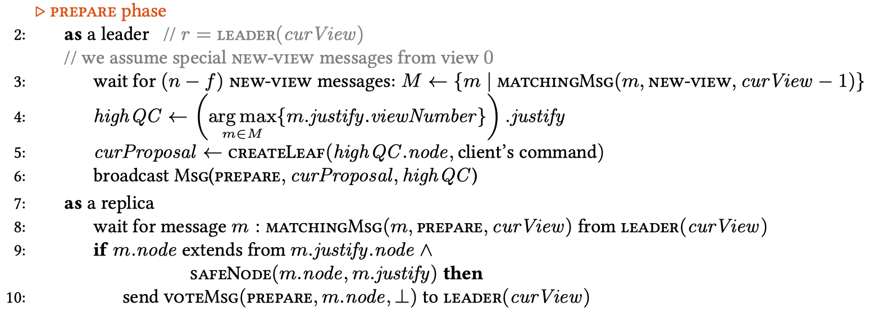
Basic HotStuff
Notes:
The protocol for a new leader starts by collecting new-view message from (n - f) replicas. The new-view message is sent by a replica as it transitions into viewNumber (including the first view) and carries the highest prepareQC that the replica received.
The leader selects the prepareQC with the highest view, denoted as highQC. Because highQC is the highest among (n-f) replicas, no higher view could have reached a commit decision. The branch led by highQC.node is therefore safe.
Upon receiving the Prepare message from the leader, replica r uses the SafeNode predicate to determine whether to accept it. If it is accepted, the replica sends a prepare vote with a partial signature for the proposal to the leader.

Slide 10
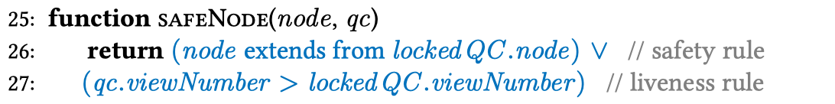
Basic HotStuff
Notes:
The safety rule to accept a proposal is the branch of m.node extends from the currently locked node lockedQC.node.
On the other hand, the liveness rule is the replica will accept m if m.justify has a higher view than the current lockedQC. The predicate is true as long as either one of two rules holds.
Extends: if a replica lost connection after the lock, and the commit didn’t get enough vote, therefore cancelled. The safety rule might not hold anymore.

Slide 11
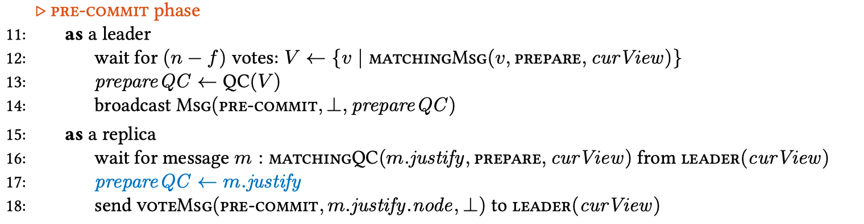
Basic Hotstuff
Notes:
When the leader receives (n-f) prepare votes for the current proposal, it combines them into prepareQC. The leader then broadcast prepareQC in pre-commit messages. A replica responds to the leader with pre-commit vote having a signed digest for the proposal.

Slide 12
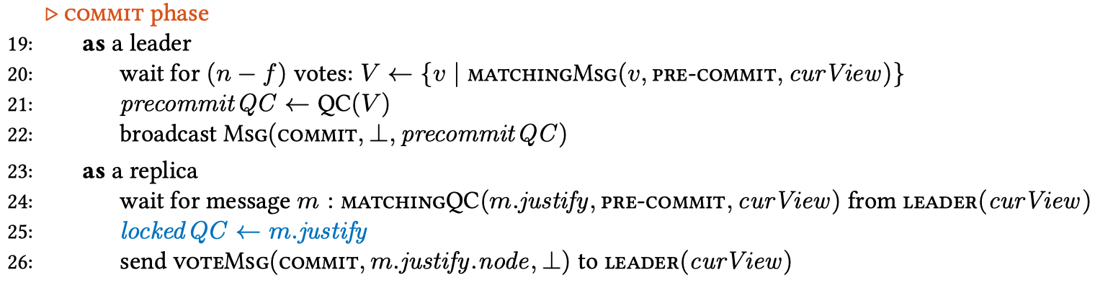
Basic HotStuff
Notes:
Commit phase is basically the same as the pre-commit phase.
Importantly, a replica becomes locked on the precommitQC at this point by setting its lockedQC to precommitQC (Line 25 of Algorithm 2). This is crucial to guard the safety of the proposal in case it becomes a consensus decision.

Slide 13
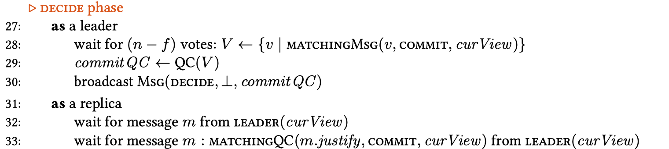
Basic HotStuff
Notes:
When the leader receives (n-f) commit votes, it combines them into commitQC and broadcast it. Once re replica receive this message, it executes the commands in the branch.

Slide 14
Basic HotStuff
Notes:
After the commit phase, each replica will increment the view number and move to the next view.
If there’s a timeout during any wait in any phase, each replica will move to the next view as well.

Slide 15
Chained HotStuff
What could be a possible improvement?
Prepare phase
(We are going to do this)
Pre-commit phase
(Maybe do stuff)
Commit phase
(Definitely do stuff)
Notes:
As we presented previously, there are total 3 phases before a success commit, however the qc that carries the message in all these phases are exactly same, which means that in all these phases, replicas are transferring same message to make a decision. Maybe we could improve the way that HotStuff transfer messages and in each phase there will be a committed command?

Slide 16
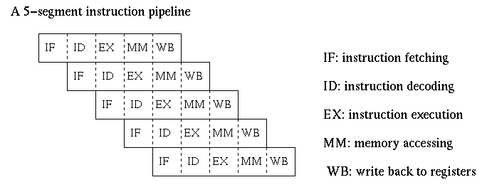
5-segment Pipeline Processor
Notes:
This recalls me a pipeline design in processor, and I suppose most of us are familiar with it. We know that in a single cycle MIPS processor, we execute a command and several part of a processor is involved, but basically only part of processor is working and other part is idle, so here comes the 5-stage pipeline processor to make idle part of the processor work to reduce the time when executing multiple commands. Such a design could also apply to HotStuff.

Slide 17
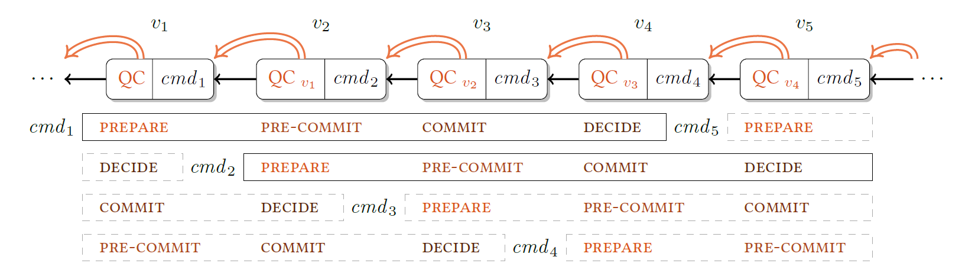
Chained HotStuff
Pipeline involved:
Chained HotStuff is a pipelined Basic HotStuff where a QC can serve in different phases simultaneously.
Notes:
Inspired by idea of pipelining, maybe we could implement a pipeline feature in basic HotStuff protocol? Since we know that each phase of HotStuff is simply communicating with other replicas, maybe it is possible to merge all those information in a general QC that contains different information required by different command? The idea is to change the view and the leader on every prepare phase, so each proposal has its own view. This reduces the number of message types and allows for pipelining of decisions. But there are several critical problems need to be solved.

Slide 18
Chained HotStuff: Critical Problems
GenericQC
Execute or not?
Interruption/disconnection happened?
Notes:
First, how could we build such a genericQC to include all information required by all command?(same qc as basic HotStuff, because previous qc is wasting resources and can be tracked by a link.)
Second, how could replicas know that a command should be executed? Since all information is included in the genericQC, how can a replica know that a command is in different phases? We know that a command can only be executed when 3 phases is complete.
Third, if there is an interruption/disconnection, how could HotStuff fix it?

Slide 19


GenericQC(1/2)
genericQC
precommitQC
commitQC
prepareQC
There are only two types of messages in Chained HotStuff, a new-view message and generic-phase generic message. The generic QC functions in all logically pipelined phases.
Notes:
As we previously introduced in the slides, there are several QC in Basic HotStuff: prepareQC, pre-commitQC, commitQC. In Chained HotStuff, we will only transfer one QC called genericQC, the genericQC is able to serve in different phases simultaneously.

Slide 20
Node structure and genericQC
Node {
parent: Node
cmd: CMD
justify: QC
}
genericQC: same to the Basic HotStuff
Types
ViewNumber
A node

Slide 21
GenericQC(2/2)
GenericQC is determined by:
QC received from leader of current view; if not, then by
highQC with maximum viewNumber:
if highQC.viewNumber > genericQC.viewNumber then genericQC <- highQC
Notes:
GenericQC is determined by two principle, the first principle is involved when there are no accident, such as disconnected, QC missing et ceterar. If there is a disconnection happened, then second principle will be involved.

Slide 22

Execute a command
Nodes at views v3, v4, v5, v6 form a Three-chain.
Notes:
Let’s say a command alpha is awaiting to be executed, the votes over a PREPARE phase are collected in a view by the leader into a genericQC. Then the genericQC is relayed to the leader of the next view, and in next phase, the command would PRE-COMMIT, to the next leader. However, the next leader does not actually carry a PRE-COMMIT phase, but instead initiates a new PREPARE phase and adds its own proposal. So it is easy to check previous view’s information with genericQC received in previous view. We also know that a command should be executed after 3 phases, so if there exist such a chain with 3 continuous view number then such a command should be executed. Here is an example of 3 continuous view number, and it is called 3-Chain. We could also conclude that if there exist 2 continuous view number or 2-chain, then the command is in pre-commit phase and will be in commit phase in next view.

Slide 23
Interrupt/Disconnection
Dummy Node:
Fails to obtain a QC.
Extends genericQC.node with blank nodes.
Notes:
Third problem what if the leader fails?
In chained hotstuff, dummy node is involved to solve this problem. It is possible that genericQC used by a leader in some view alpha may not directly reference the proposal of the preceding view (alpha - 1). The reason is that the leader of a preceding view fails to obtain a QC, either because there are conflicting proposals, or due to a crash. To simplify the tree structure, we extends node in genericQC with blank nodes up to the height of the proposing view, so view-numbers are equated with node heights.

Slide 24
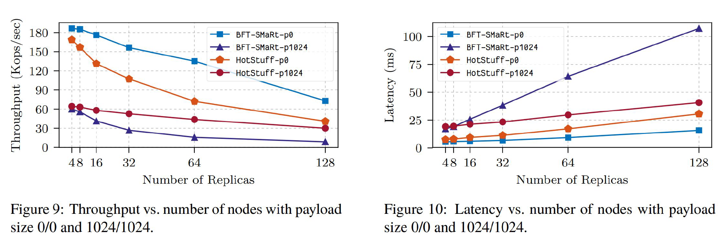
Performance - HotStuff vs BFT-SMaRt
Notes:
So, how is the performance of HotStuff? Compare with BFT-Smart, we could see that Hotstuff lines are between the lines of BFT-smart, which means that hotstuff is more stable than BFT-smart in various situations.

Slide 25
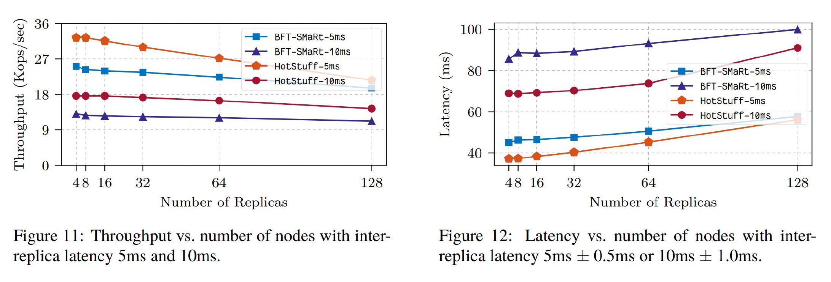
Performance - HotStuff vs BFT-SMaRt
Notes:
So, how is the performance of HotStuff? Compare with BFT-Smart, we could see that Hotstuff lines are between the lines of BFT-smart, which means that hotstuff is more stable than BFT-smart in various situations.

Slide 26
Questions?

Slide 27
Thanks!

